Slide 1
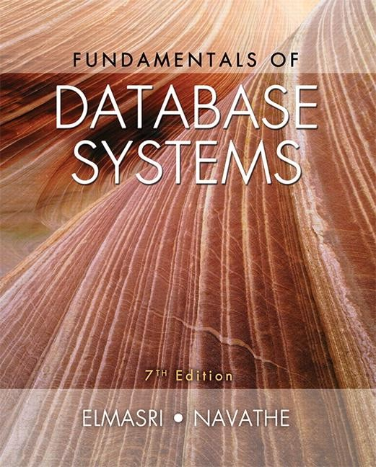
Copyright © 2016 Ramez Elmasri and Shamkant B. Navathe

Slide 2
CHAPTER 1
Databases and Database Users

Slide 3
OUTLINE
Basic Definitions and Types of Databases and Database Applications
Typical DBMS Functionality
Example of a Database (UNIVERSITY)
Main Characteristics of the Database Approach
Advantages of Using the Database Approach
Types of Database Users

Slide 4
Basic Definitions and Concepts

Slide 5
Basic Definitions
Database:
A collection of organized related data to serve a given purpose.
Data: Known facts that can be recorded and have an implicit meaning.
Database Management System (DBMS):
A software package/ system to facilitate the creation and maintenance of a computerized database.
Database System:
The DBMS software together with the data itself. Sometimes, the applications are also included.

Slide 6
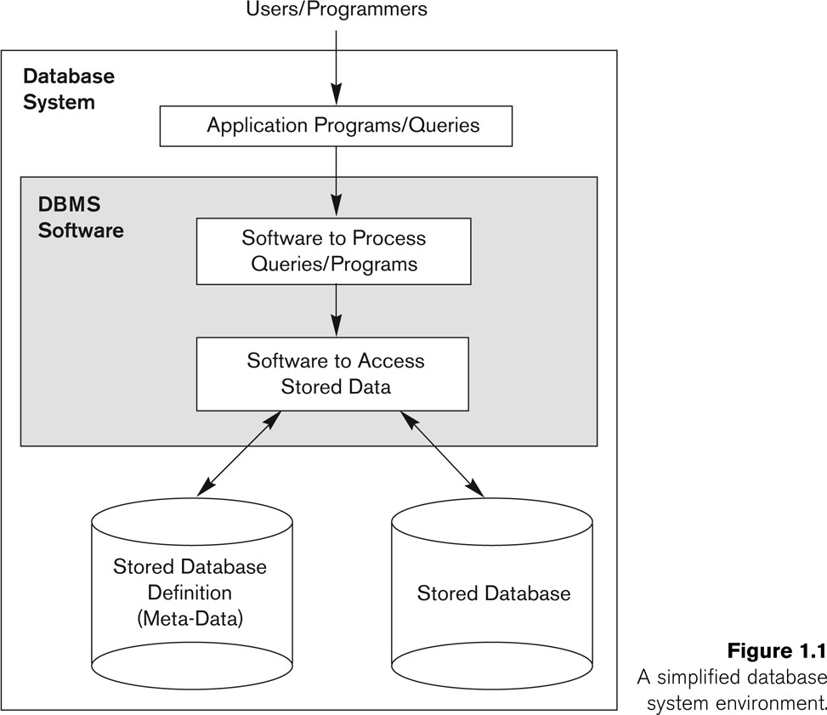
Simplified database system environment

Slide 7
Types of Databases and Database Applications
Traditional Applications:
Numeric and
Textual Databases
More Recent Applications:
Multimedia Databases
Geographic Information Systems (GIS)
Biological and Genome Databases
Data Warehouses
Mobile databases
Real-time and Active Databases

Slide 8
Impact of Databases and Database Technology
Businesses: Banking, Insurance, Retail, Transportation, Healthcare, Manufacturing
Service Industries: Financial, Real-estate, Legal, Electronic Commerce, Small businesses
Education : Resources for content and Delivery
More recently: Social Networks, Environmental and Scientific Applications, Medicine and Genetics
Personalized Applications: based on smart mobile devices

Slide 9
Typical Functionality of DBMS
1. Define a particular database in terms of its data types, structures, and constraints
2. Construct or Load the initial database contents on a secondary storage device.
3. Manipulating the database:
Retrieval: Querying, generating reports
Modification: Insertions, deletions and updates to its content
Accessing the database through Web applications
4. Processing and Sharing by a set of concurrent users and application programs – yet, keeping all data valid and consistent

Slide 10
Additional Functionality of DBMS
DBMS may additionally provide:
Protection or Security measures to prevent unauthorized access
“Active” processing to take internal actions on data
Presentation and Visualization of data
System and software Maintenance of the database and associated programs over the lifetime of the database application.

Slide 11
Database Applications
Applications interact with a database by generating
Queries: that access different parts of data and formulate the result of a request
Update Transactions: that may read some data and “update” certain values or generate new data and store that in the database
Applications must not allow unauthorized users to access data
Applications must keep up with changing user requirements against the database

Slide 12
Example of a Database (with a Conceptual Data Model)

Slide 13
Example of a Database
(with a Conceptual Data Model)
Application area of the example:
Part of a UNIVERSITY environment.
Some entities in the example:
STUDENTs
COURSEs
SECTIONs (of COURSEs)
(academic) DEPARTMENTs
INSTRUCTORs

Slide 14
Example of a Database
(with a Conceptual Data Model)
Some relationships between entities:
SECTIONs are of specific COURSEs
STUDENTs take SECTIONs
COURSEs have prerequisite COURSEs
INSTRUCTORs teach SECTIONs
COURSEs are offered by DEPARTMENTs
STUDENTs major in DEPARTMENTs
Note: The above entities and relationships are typically expressed in a conceptual data model (see next slide), such as the ENTITY-RELATIONSHIP data model (discussed later)

Slide 15
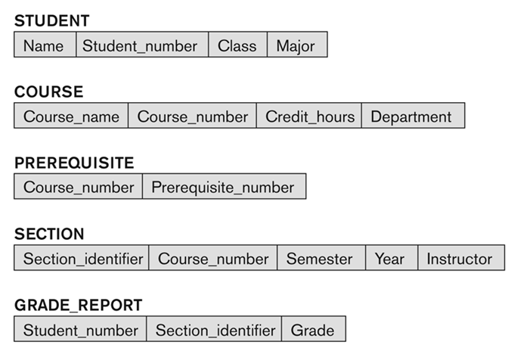
Conceptual Model of Data in Figure 1.2 (next slide)

Slide 16
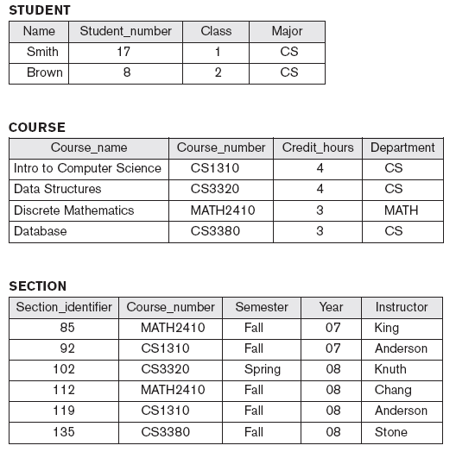
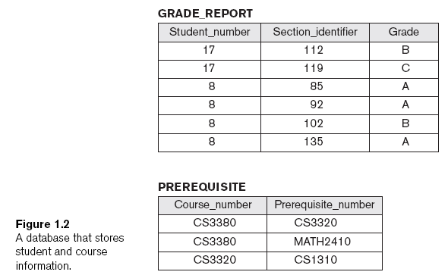
Example of a simple database

Slide 17
An Example (cont'd.)
Examples of queries:
Retrieve the transcript.
List the names of students who took the section of the ‘Database’ course offered in fall 2008 and their grades in that section.
List the prerequisites of the ‘Database’ course

Slide 18
An Example (cont'd.)
Examples of updates:
Change the class of ‘Smith’ to sophomore.
Create a new section for the ‘Database’ course for this semester.
Enter a grade of ‘A’ for ‘Smith’ in the ‘Database’ section of last semester

Slide 19
The Database Approach

Slide 20
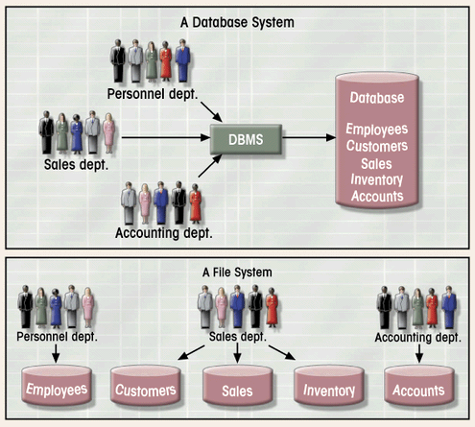
Database vs. File Systems

Slide 21
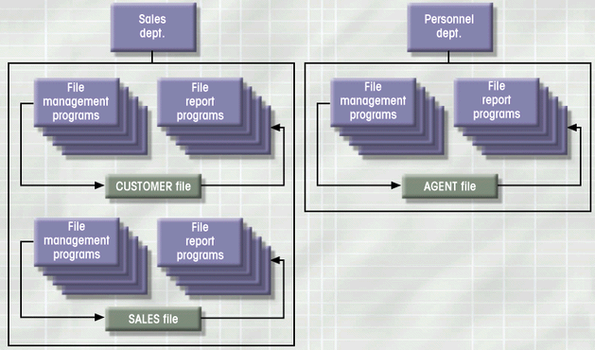
Simple File System: An Example

Slide 22
Main Characteristics of the Database Approach
1. Self-describing nature of a database system:
A DBMS catalog stores the description of a particular database (e.g. data structures, types, and constraints)
(see next slide)
This description is called meta-data (that is data about data).
This allows the DBMS software to work with different database applications.
2. Insulation between programs and data:
This is called program-data independence.
Allows changing data structures and storage organization without having to change the DBMS access programs.

Slide 23
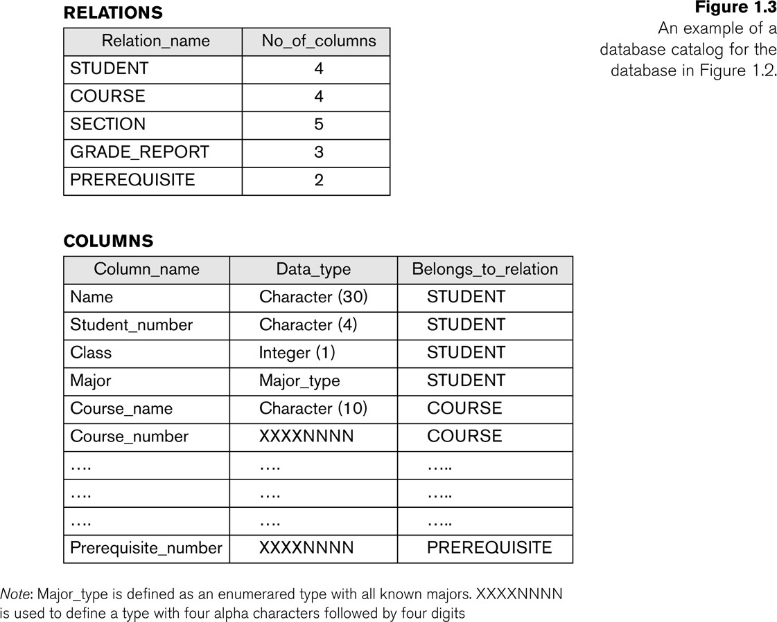
Example of a simplified database catalog

Slide 24
Main Characteristics of the Database Approach (continued)
3. Data Abstraction:
A data model is used to hide storage details (see next slide) and present the users with a conceptual view of the database.
Programs refer to the data model constructs rather than data storage details
4. Support of multiple views of the data:
Each user may see a different view of the database, which describes only the data of interest to that user.

Slide 25
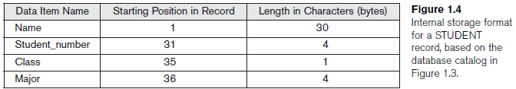
Internal Storage Format

Slide 26
Main Characteristics of the Database Approach (continued)
5. Sharing of data and multi-user transaction processing:
Allowing a set of concurrent users to retrieve from and to update the database.
Concurrency control within the DBMS guarantees that each
transaction is correctly executed or aborted
Recovery subsystem ensures each completed transaction has its effect permanently recorded in the database
OLTP (Online Transaction Processing) is a major part of database applications. This allows hundreds of concurrent transactions to execute per second.

Slide 27
Advantages of the Database Approach

Slide 28
Advantages of Using the Database Approach
Controlling redundancy in data storage and in development and maintenance efforts.
Representing complex relationships among data.
Providing storage structures (e.g. indexes) for efficient query processing.
Enforcing integrity constraints on the database.

Slide 29
Advantages of Using the Database Approach (continued)
Providing
optimization of queries for efficient processing.
backup and recovery services.
multiple interfaces to different classes of users.
sharing of data among multiple users.
Restriction of unauthorized access to data. Only the DBA staff uses privileged commands and facilities.

Slide 30
Additional Implications of Using the Database Approach
Potential for enforcing standards:
This is very crucial for the success of database applications in large organizations. Standards refer to data item names, display formats, screens, report structures, meta-data (description of data), Web page layouts, etc.
Reduced application development time:
Incremental time to add each new application is reduced.
Notes:
Section 2

Slide 31
Additional Implications of Using the Database Approach (continued)
Flexibility to change data structures:
Database structure may evolve as new requirements are defined.
Availability of current information:
Extremely important for on-line transaction systems such as shopping, airline, hotel, car reservations.
Economies of scale:
Wasteful overlap of resources and personnel can be avoided by consolidating data and applications across departments.

Slide 32
Database Users

Slide 33
Database Users
Users may be divided into two groups:
1. Those who actually use and control the database content, and those who design, develop and maintain database applications (called “Actors on the Scene”), and
2. Those who design and develop the DBMS software and related tools, and the computer systems operators (called “Workers Behind the Scene”).

Slide 34
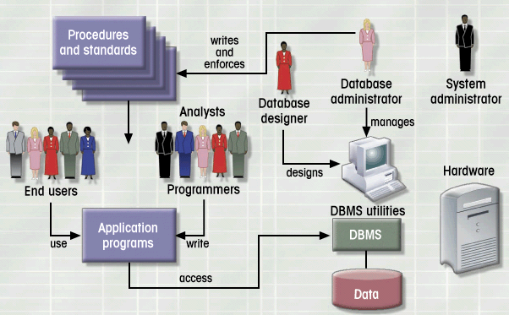
Database System Environment and Users

Slide 35
Database Users – Actors on the Scene
Actors on the scene
Database Administrators (DBA):
Responsible for authorizing access to the database, for coordinating and monitoring its use, acquiring software and hardware resources, controlling its use and monitoring efficiency of operations.
Database Analysts and Designers:
Responsible for defining the content, the structure, the constraints, and functions or transactions against the database. They must communicate with the end-users and understand their needs.

Slide 36
Database End Users
Actors on the scene (continued)
Database Application Developers: This includes: system analysts, application programmers, and business analysts.
Database End-users: They use the data for queries, reports and some of them update the database content.
Copyright © 2016 Rwameez Eblmsasirti eandsShamkant B. Navathe

Slide 37
Database Users – Workers behind the Scene
System Designers and Implementors:
They design and implement DBMS packages in the form of modules and interfaces and test and debug them.
Tool Developers:
They design and implement software systems called tools that facilitate building of applications and allow using database effectively.
Operators and Maintenance Personnel:
They manage the actual running and maintenance of the database system hardware and software environment.

Slide 38
Chapter Summary
Types of Databases and Database Applications
Basic Definitions
Typical DBMS Functionality
Example of a Database (UNIVERSITY)
Main Characteristics of the Database Approach
Types of Database Users
Advantages of Using the Database Approach
Extending Database Capabilities
When Not to Use Databases

